Slide 1
Basic Biological Concepts
Homeostasis and Regulation II
Section 3 – Lecture 4

Slide 2
What is Homeostasis?
Homeostasis is the automatic system for maintaining optimum ranges for important internal conditions that allows organisms to survive in their changing environment.
These optimum ranges produce optimal functioning for the cells and tissues.
These variables need to be regulated and steady within certain pre-set limits, despite changes in environmental conditions, diet and/or level of activity.
The study of homeostasis and the mechanisms that maintain it underpin the science of physiology.

Slide 3
The metabolic processes of all organisms can only take place in very specific physical and chemical environments, both inside the cell and in the interstitial fluid bathing the cells.
The best known homeostatic mechanisms in mammals are regulators that keep the composition of the extracellular fluid (or the "internal environment") constant.
Important terminology: Where the levels of variables are higher or lower than the pre-set levels, they are often prefixed with hyper- and hypo-, respectively.
hyperthermia and hypothermia: too hot and too cold, relative to homeostatic “set points”
hypertension and hypotension: too high and too low blood pressure

Slide 4
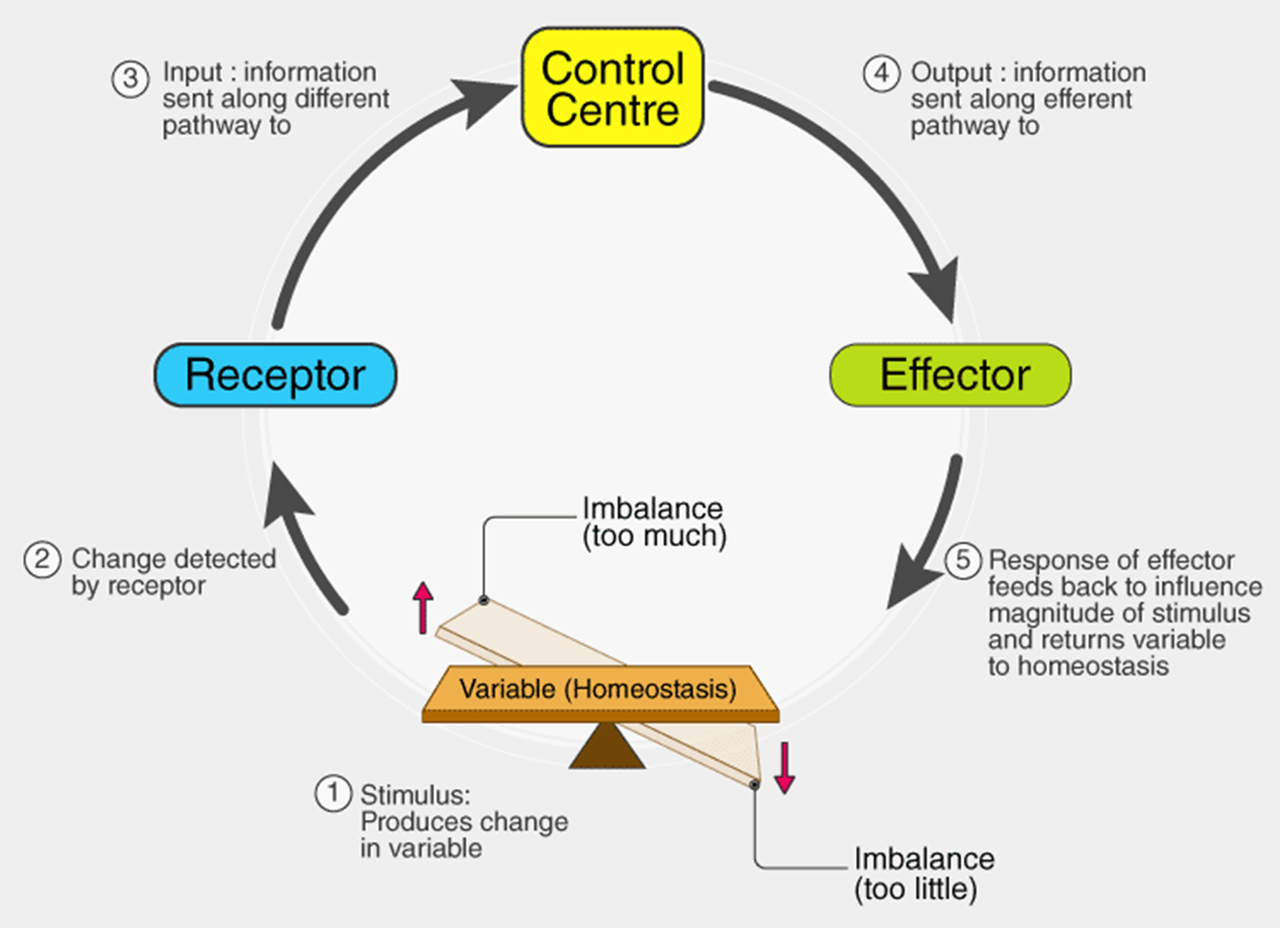
Homeostatic control mechanisms have three interdependent components for the variable being regulated.
Homeostatic Receptors are sensing components that monitor the variable and respond to changes by sending signals to the Control Center.
Homeostatic Control Centers set the acceptable upper and lower limits for the variable, and respond to the receptor signal by determining an appropriate response and sending signals to the Effector.
Homeostatic Effectors bring the variable back within the normal range. They usually include negative feedback mechanisms that shut down Receptor signals and the Control Center response.

Slide 5
The Neurendocrine System
The hypothalamus in the brain is the Control Center for many homeostatic mechanisms, regulating metabolism, reproduction, eating and drinking behavior, energy utilization, and blood pressure, among others.
This regulation is carried out by hypothalamic interconnections to other glands, or Effectors, as we will see in this lecture:
The hypothalamic–pituitary–gonadal axis (HPG axis)
The hypothalamic–pituitary–adrenal axis (HPA axis)
The hypothalamic–pituitary–thyroid axis (HPT axis).

Slide 6
Clinical significance
Many diseases are the result of a homeostatic failure.
Almost any homeostatic component can malfunction either as a result of an inherited defect, an inborn error of metabolism, or an acquired disease.
Some homeostatic mechanisms have inbuilt redundancies, which ensures that life is not immediately threatened if a component malfunctions
Sometimes a homeostatic malfunction can result in serious disease, which can be fatal if not treated.
A well-known homeostatic failure is type 1 diabetes mellitus. Blood sugar regulation is unable to function because the beta cells of the pancreatic islets are destroyed and cannot produce the necessary insulin.
The blood sugar rises in a condition known as hyperglycemia.

Slide 7
Selected Homeostatically Controlled Variables
Fluid balance
Arterial blood pressure
Core temperature
Blood pH
Levels of blood gases
Blood glucose
Calcium levels
Iron levels
Energy balance

Slide 8
1. Fluid Balance
All multicellular organisms on Earth maintain an aqueous environment
All plants and animals have water in their cells and in the extracellular matrix
Beyond that, variation in water regulation can be specific to the organism:
Some also have water in a vascular system that can exchange that water with tissues
Animals with a GI or respiratory systems also exchange water with those systems
Vertebrate animals also have a specialized cerebrospinal and lymphatic fluid systems

Slide 9
Fluid Balance involves the close relationship between water and electrolytes
Because of osmosis, body water goes to where electrolytes are concentrated.
When body water is lost, it causes the extracellular fluid to become highly concentrated with electrolytes, particularly sodium.
Water loss occurs through the skin (not entirely waterproof), water vapor in the exhaled air, sweating, vomiting, normal feces and especially diarrhea.
This extracellular fluid is called hypertonic or hyperosmolar (high total dissolved material), and hypernatremic (high dissolved Na⁺).
The fluid balance is called hypovolemic (low water volume)
Conversely, excessive fluid intake dilutes the extracellular fluid causing hypotonic, hyponatremic and hypervolemic conditions.

Slide 10
Fluid Balance is maintained by a balance between hypothalamus and kidney activity.
Fluid Balance Receptors: 1. Osmoreceptors in the hypothalamus detect total dissolved material, and 2. the juxtaglomerular cells of the kidney detect plasma sodium concentration.
Fluid Balance Control Centers: 1. The hypothalamus secretes an antidiuretic hormone (ADH) called vasopressin under hypertonic conditions, and 2. The kidney secretes renin under hyponatremic conditions.
Fluid Balance Effectors: Kidney secretion and absorption of water and sodium, and thirst.

Slide 11
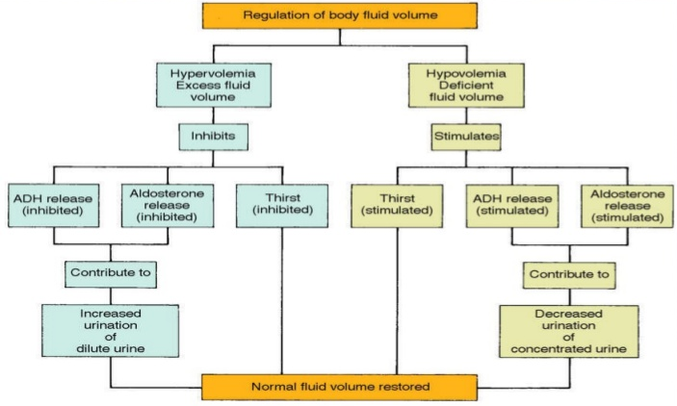
Hypo-osmolality results in very low vasopressin.
This inhibits water reabsorption, causing high volumes of very dilute urine to be excreted.
Hyponatremia causes kidney cells to release renin into the blood.
Renin causes the release of aldosterone from adrenal glands.
Aldosterone causes the reabsorption of sodium ions.
The hyponatremia can only be corrected by the consumption of salt in the diet.
Hyper-osmolality results in high vasopressin.
Vasopressin causes the kidney to reabsorb water, thus preventing aggravation of the water loss via the urine.
Stimulation of the thirst center causes an almost irresistible urge to drink water.
Cessation of urine flow prevents the hypovolemia and hypertonicity from getting worse
The drinking of water corrects the defect.

Slide 12
2. Arterial Blood Pressure
Blood Pressure is a critical homeostatic parameter.
The entire cardiovascular system functions on the basis of the heart creating high pressure to send the blood through the increasingly low pressure blood vessel system.
It is particularly important for animals walking upright with the head at the top, as the brain relies heavily on oxygen and glucose in the blood and cannot function if there is not enough pressure to move blood up.
Blood Pressure Receptors: 1. High pressure receptors called baroreceptors in the aortic arch and carotid artery, 2. The walls of the heart muscle, and 3. Secondarily, the juxtaglomerular cells of the kidney.
Blood Pressure Control Centers: 1. The medulla oblongata of the brain which controls the output of the autonomic nervous system, 2. Rising pressure causes heart muscle cells to secrete the hormone atrial natriuretic peptide (ANP) , and 3. The kidney secretes renin under hypotension conditions.
Blood Pressure Effectors: 1. Vasoconstriction and vasodilation of the arteries, 2. Force of contraction in the heart, and 3. Kidney secretion and absorption of water and sodium.

Slide 13
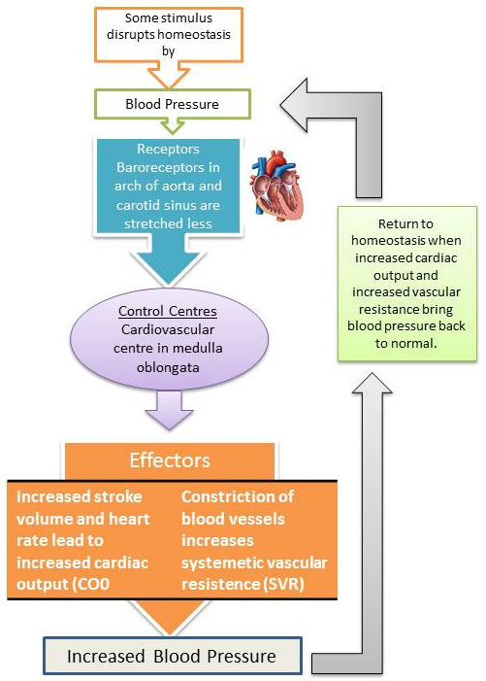
Rising pressure causes heart muscle cells to secrete the hormone atrial natriuretic peptide (ANP) into the blood.
This acts on the kidneys to inhibit the secretion of renin and aldosterone causing the secretion of sodium and water, thereby reducing the blood volume.
This information is sent to the medulla oblongata which stimulates the autonomic nervous system to relax the blood vessels and lower pressure.
At the same time the heart is stimulated to beat more slowly (called bradycardia), ensuring that the inflow of blood into the arteries is reduced.
Low pressure in the arteries, causes the opposite reflex of constriction of the arterioles, and a speeding up of the heart rate (called tachycardia).
If the drop in blood pressure is very rapid or excessive, the medulla oblongata stimulates the adrenal medulla to secrete adrenaline into the blood.
Angiotensin II also acts on the smooth muscle in the walls of the arterioles causing them to constrict, thereby restricting the outflow of blood from the arterial tree, causing the arterial blood pressure to rise.
These reactions usually correct the low arterial blood pressure (hypotension) very effectively.

Slide 14
3. Core Temperature
Core Temperature Receptors: Thermoreceptors in the hypothalamus, brain, spinal cord, internal organs, and great veins.
Core Temperature Control Centers: The hypothalamus and its control over the autonomic nervous system
Core Temperature Effectors: Blood vessel smooth muscle, sweat glands of the skin, skeletal muscle
Apart from the internal regulation of temperature, a process called allostasis can come into play that adjusts behaviour to adapt to the challenge of very hot or cold extremes (and to other challenges).
These adjustments may include seeking shade and reducing activity, or seeking warmer conditions and increasing activity, or huddling.
Behavioural thermoregulation takes precedence over physiological thermoregulation since necessary changes can be affected more quickly and physiological thermoregulation is limited in its capacity to respond to extreme temperatures.

Slide 15
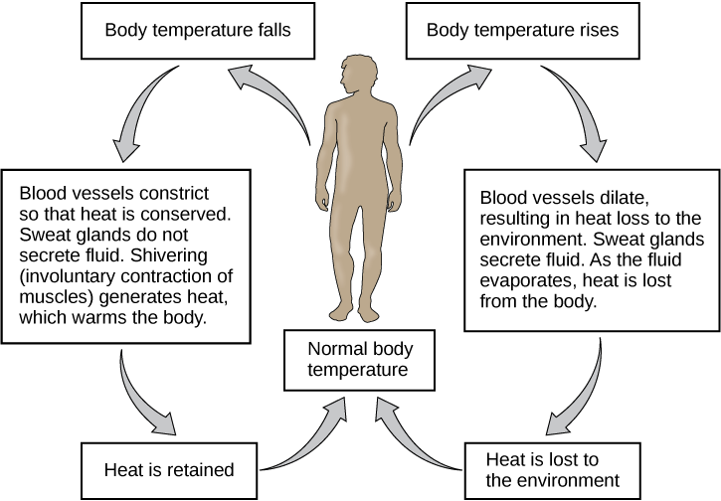
Decreased temperature is detected by hypothalamus
Blood flow to the skin is reduced by intense vasoconstriction.
Blood flow to the limbs (large surface area) is similarly reduced, and returned to the trunk via the deep veins which lie alongside the arteries.
This shunts the warmth from the arterial blood directly into the venous blood returning into the trunk.
Metabolic rate is increased, initially by non-shivering thermogenesis, followed by shivering thermogenesis.
Increased core temperatures are detected by thermoreceptors.
Sweat glands in the skin are stimulated via cholinergic sympathetic nerves
Evaporation cools the skin and the blood flowing through it.
Panting is an alternative effector in many vertebrates
Cools the body by the evaporation of water, but this time from the mucous membranes of the throat and mouth.

Slide 16
4. Blood pH
The plasma pH can be altered by respiratory changes in the partial pressure of carbon dioxide; or altered by metabolic changes in the carbonic acid to bicarbonate ion ratio.
The bicarbonate buffer system regulates the ratio of carbonic acid to bicarbonate to be equal to 1:20, at which ratio the blood pH is 7.4.
The sensor for the plasma bicarbonate concentration is not known for certain. It is very probable that the renal tubular cells of the distal convoluted tubules are themselves sensitive to the pH of the plasma.
A change in the plasma pH gives an acid–base imbalance.
In acid–base homeostasis there are two mechanisms that can help regulate the pH.
Respiratory compensation a mechanism of the respiratory center, adjusts the partial pressure of carbon dioxide by changing the rate and depth of breathing, to bring the pH back to normal.
The partial pressure of carbon dioxide also determines the concentration of carbonic acid, and the bicarbonate buffer system can also come into play. Renal compensation can help the bicarbonate buffer system.

Slide 17
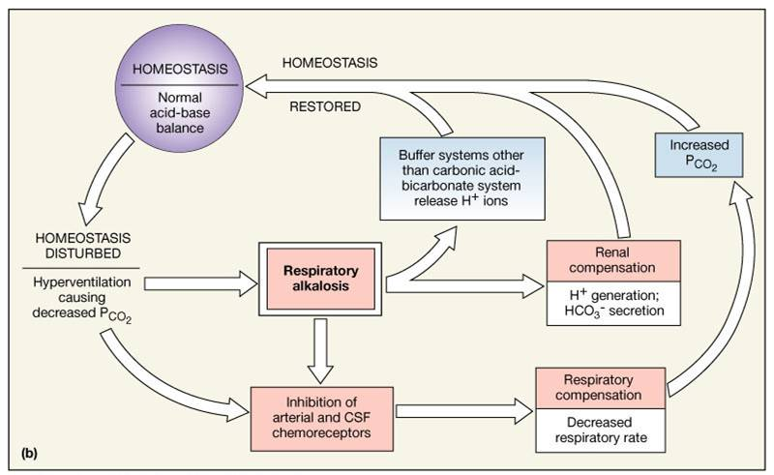
Kidney cells produces carbon dioxide, which is rapidly converted to hydrogen and bicarbonate via carbonic anhydrase.
When the pH falls the kidney cells excrete hydrogen ions into the urine.
Bicarbonate ions are simultaneously secreted into the blood to decrease the carbonic acid, and raise the plasma pH.
The converse happens when the plasma pH rises above normal: bicarbonate ions are excreted into the urine, and hydrogen ions released into the plasma.
Increased carbonic acid is in equilibrium with the plasma carbon dioxide.
The rise mops up the increased hydrogen ions (caused by the fall in plasma pH)
The excess carbonic acid is disposed of in the lungs as carbon dioxide.
The converse happens with a high plasma pH: hydrogen ions put into the blood, bicarbonate into the urine.
Hydrogen ions combine with excess bicarbonate ions in the plasma
Carbonic acid is exhaled as carbon dioxide

Slide 18
5. Levels of Blood Gasses
Blood Gas Receptors: 1. The partial pressure of oxygen and carbon dioxide in the arterial blood is monitored by the peripheral chemoreceptors (PNS) in the carotid artery and aortic arch. 2. Change in the partial pressure of carbon dioxide is detected as altered pH in the cerebrospinal fluid by central chemoreceptors (CNS) in the medulla oblongata of the brainstem.
Blood Gas Control Center: Changes in the levels of oxygen, carbon dioxide, and plasma pH are sent to the respiratory center in the brainstem where they are regulated.
Blood Gas Effectors: The diaphragm and other muscles of respiration.
An increased level of carbon dioxide in the blood, or a decreased level of oxygen, will result in a deeper breathing pattern and increased respiratory rate to bring the blood gases back to equilibrium.
Too little carbon dioxide, and, to a lesser extent, too much oxygen in the blood can temporarily halt breathing, a condition known as apnea, which freedivers use to prolong the time they can stay underwater.
The partial pressure of carbon dioxide is more of a deciding factor in the monitoring of pH. However, at high altitude (above 2500 m) the monitoring of the partial pressure of oxygen takes priority, and hyperventilation keeps the oxygen level constant.
With the lower level of carbon dioxide, to keep the pH at 7.4 the kidneys secrete hydrogen ions into the blood, and excrete bicarbonate into the urine. This is important in the acclimatization to high altitude.

Slide 19
6. Blood Glucose
Blood sugar levels are regulated within fairly narrow limits.
Blood Glucose Receptors: In mammals the primary sensors for this are the beta cells of the pancreatic islets.
Blood Glucose Control Center: The pancreas. Under conditions of high glucose the beta cells secrete insulin into the blood and simultaneously inhibit their neighboring alpha cells from secreting glucagon into the blood. When glucose is low the beta cells stop secreting insulin and alpha cells are free to secrete glucagon.
Blood Glucose Effectors: The liver, fat cells and muscle cells.

Slide 20
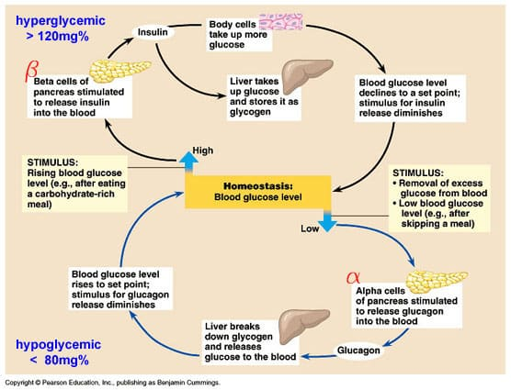
The liver is inhibited from producing glucose, taking it up instead, and converting it to glycogen and triglycerides.
Glycogen is stored in the liver, but triglycerides are secreted into the blood and taken up by adipose tissue.
Fat cells also take up glucose through special glucose transporters (GLUT4), whose numbers in the cell wall are increased as a direct effect of insulin acting on these cells.
Glucose is converted and stored as fat, together with those made in the liver.
Muscle cells also take glucose up through insulin-sensitive GLUT4 glucose channels, and convert it into glycogen.
A fall in blood glucose stops insulin secretion and raises glucagon secretion.
This inhibits glucose uptake by the liver, fat cells and muscle.
The liver is stimulated to manufacture glucose and secrete it into the blood.
The glycogen stored in muscles remains in the muscles.
Lactate wastes from muscle are returned to the blood.
These are taken up by liver and converted back to glucose.

Slide 21
7. Calcium Levels
The plasma calcium (Ca²⁺) concentration is very tightly controlled.
The skeleton acts as an extremely large calcium store (about 1 kg) compared with the plasma calcium store (about 180 mg).
Longer term regulation occurs through calcium absorption or loss from the gut.
Calcium Level Receptors: 1. The chief cells the parathyroid glands sense the Ca²⁺ level by means of specialized calcium receptors in their membranes. 2. The sensors for the second are the parafollicular cells in the thyroid gland.
Calcium Level Control Centers: 1. The chief cells secrete parathyroid hormone (PTH) in response to low calcium levels, and 2. The parafollicular cells secrete calcitonin in response to high calcium levels.
Calcium Level Effectors: PTH causes calcium release from bone stores, whereas calcitoning cause calcium deposition into bone.

Slide 22
8. Iron Levels
Iron is an essential bioelement for most forms of life, from bacteria to mammals.
Iron is both necessary to the body and potentially toxic. Controlling iron levels in the body is a critically important part of many aspects of human health and disease.
Understanding iron metabolism is also important for understanding diseases of iron overload, such as hereditary hemochromatosis, and iron deficiency, such as iron deficiency anemia.
Human iron homeostasis is regulated at three different points.
Controlled absorption of dietary iron by intestinal cells
Uncontrolled loss of iron from epithelial sloughing, sweat, injuries and blood loss.
Continuous recycling of systemic iron.

Slide 23
The absorption of dietary iron is a variable and dynamic process.
The percent of ingested iron that is absorbed may range from 5% to as much as 35%.
The best-absorbed forms of iron come from animal products, in the form of heme iron.
Absorption of iron supplements in iron salt form is usually between 10% and 20%.
The body also absorbs less iron during times of inflammation, in order to deprive bacteria of iron.
Those who cannot regulate absorption well enough get disorders of iron overload. In these diseases, the toxicity of iron starts overwhelming the body's ability to bind and store it
Iron loss
There is no physiologic regulatory mechanism for excreting iron.
People lose a small but steady amount by gastrointestinal blood loss, sweating and by shedding cells of the skin and the mucosal lining of the gastrointestinal tract.
The total amount of loss for healthy people is estimated at 1 mg a day for men, and 1.5–2 mg a day for women with regular menstrual periods.
People with gastrointestinal parasitic infections, more commonly found in developing countries, often lose more.
Iron recycling
Most of the iron in the body is hoarded and recycled by the reticuloendothelial system, which breaks down aged red blood cells.

Slide 24
9. Energy Balance
The amount of energy taken in through nutrition needs to match the amount of energy used.
To achieve energy homeostasis appetite is regulated by two hormones, grehlin and leptin. Grehlin stimulates hunger and the intake of food and leptin acts to signal satiety (fullness).
A 2019 review of weight-change interventions, including dieting, exercise and overeating, found that body weight homeostasis could not precisely correct for "energetic errors", the loss or gain of calories, in the short-term.

